Slide 1
My Text in Your
Tom S. F. Haines, Oisin Mac Aodha, and Gabriel J. Brostow
University College London

Slide 2
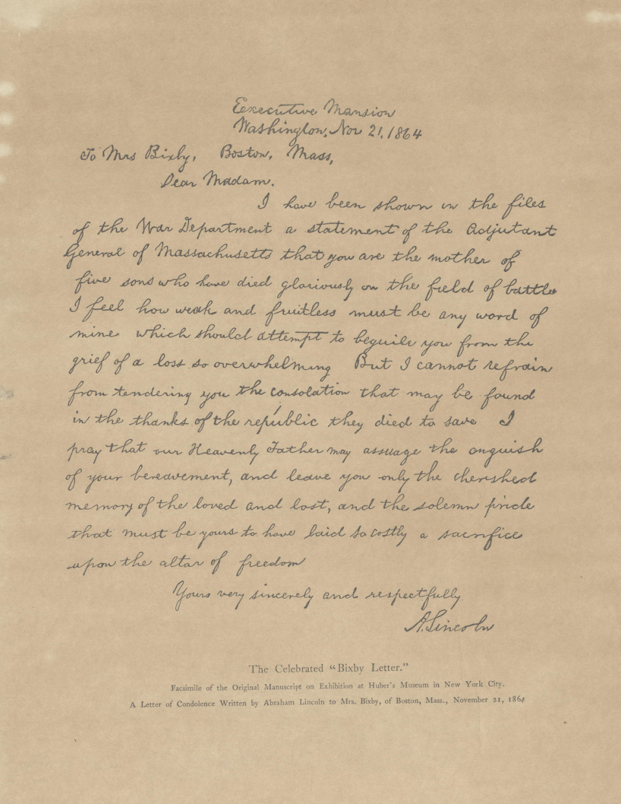
Handwriting
A very personal form of
communication
Notes:
The worldwide adoption of digital messaging has given handwritten communication a special status as the approach for important, personally expressive messages.

Slide 3
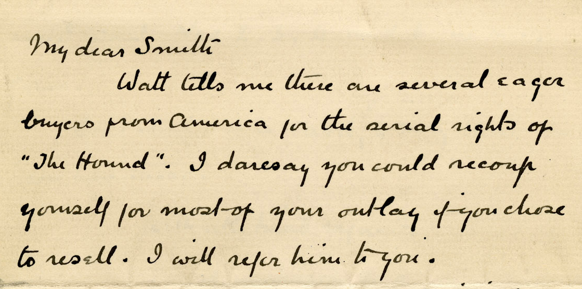
Input
+
elementary my dear Watson
Notes:
In this work, we present an algorithm for generating realistic handwritten text in a given style.
As input, all we need is an example of the writing style on paper and the (C) target text that we wish to generate.
We do not require any specialist capture devices such as tablets, and place no restriction on the type of writing implement used.

Slide 4
Input
Output
+
elementary my dear Watson
Notes:
Here we show our system generating a piece of text in the style of the Sherlock Holmes author - Arthur Conan Doyle.

Slide 5
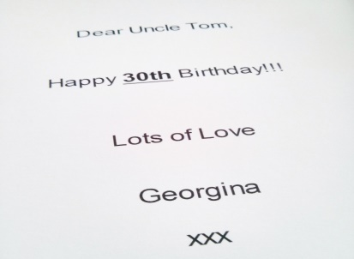
Applications
Gifts and Letters
Notes:
There are many scenarios where we would wish to imitate a specific authors pen-on-paper writing style.
Gifts ordered from online retailers and flower shops could include personal messages, but they are currently rendered in an impersonal font.

Slide 6
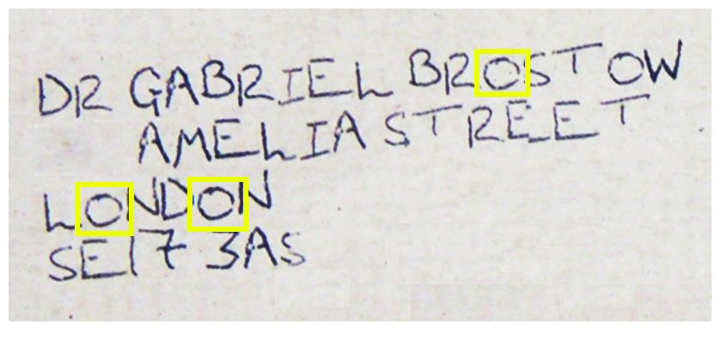
Applications
Gifts and Letters
Camouflage
Notes:
Sensitive materials such as credit cards can be intercepted when sent through the post.
Some banks use synthesized handwriting as camouflage, but these current systems typically do not stand up to closer inspection as there can be obvious repetitions of characters.

Slide 7
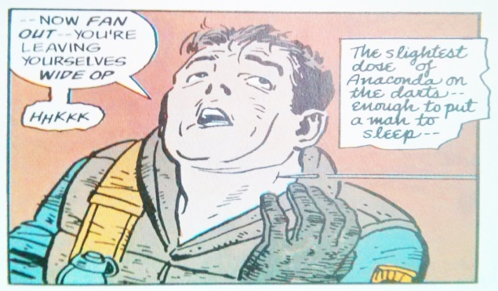
Applications
Artistic
Gifts and Letters
Frank Miller - Batman Year One
Camouflage
Notes:
In artistic applications, comics could include text in handwritten lettering, and automatic synthesis could be used to preserve the writing style when changing to a foreign language.
Similarly for video games, where text is often dynamic and can appear in large quantities, manual creation of the handwritten text would be expensive in terms of both time and memory.

Slide 8
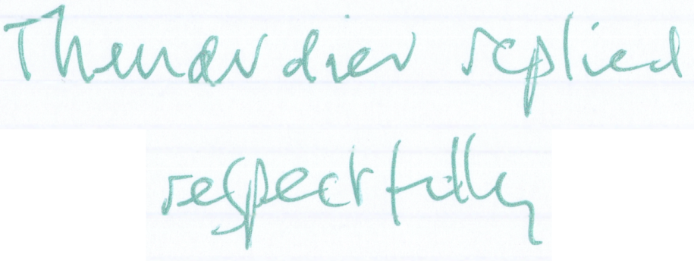
Applications
Artistic
Gifts and Letters
Frank Miller - Batman Year One
Camouflage
Assistive Technology
Notes:
Finally, the author of this example has suffered a stroke which has both changed their handwriting style and affected the legibility of their writing.
Automatic synthesis based on historical scans of their handwriting would enable them to generate new text in their original style.

Slide 9
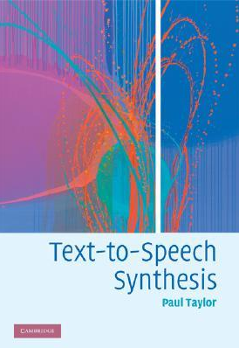
Related Work - Structured Synthesis
Kwatra et al. 2003
Taylor 2009
Sun et al. 2005
Notes:
Automatic handwriting generation can be viewed as a special case of structured synthesis.
Users place constraints on the output in the form of the characters required to make up the desired sentence.
The majority of work in conventional texture synthesis does not deal with the scenario where this supervised information is available.
As we will show in this presentation there are many handwriting specific factors that need to be taken into account to render realistic looking handwriting.

Slide 10
Related Work - Handwriting Fonts
inspired by Knuth 1979
Notes:
The simplest way to generate text that looks handwritten is to use one of the many different handwriting fonts that are available.
This approach dates back to the font work of Donald Knuth in the 70s.

Slide 11
Related Work - Handwriting Fonts
inspired by Knuth 1979
Notes:
However, the problem with these fonts is that they typically replicate glyphs and thus lack the natural variability and flow present in real handwritten text.

Slide 12
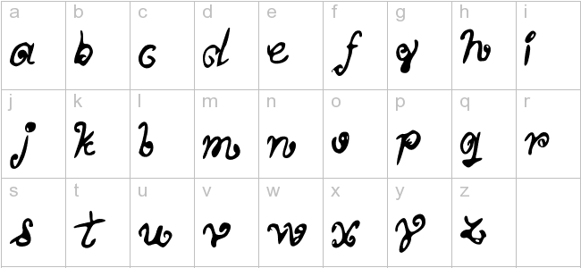
Related Work - Single Characters
MyScriptFont.com – commercial service
Notes:
Services exist that enable the creation of custom handwriting like fonts based on the vectorization of individual glyphs provided by users.
However, these approaches again lack variability, texture, and the long range interactions between elements.

Slide 13
Related Work - Single Characters
MyScriptFont.com – commercial service
Notes:
Rendering new text in someone’s handwriting is difﬁcult because natural handwriting is highly variable, yet contains both intentional and involuntary structure that makes a person’s style self-consistent.
This variability means that naïve example-based texture synthesis can be conspicuously repetitive.

Slide 14
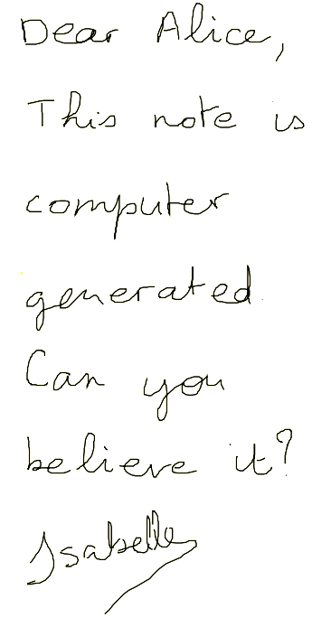
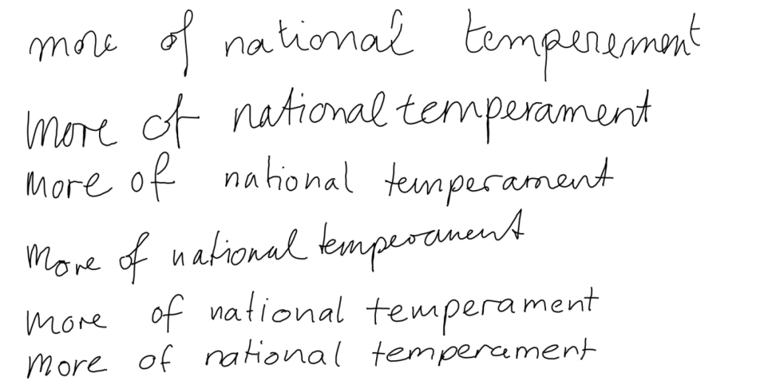
Related Work - Tablet Input
Graves 2013
Guyon 1996
Notes:
To date, most work in handwriting synthesis has focused on generating text using data captured from tablets.
Using tablets bypasses problems such as segmenting the text from images and can also give some timing information.
Some of these approaches can produce natural looking text but lack the texture of different pen styles.

Slide 15
Related Work - Tablet Input
Graves 2013
Guyon 1996
Notes:
As they require vectorized input and pen timings these approaches cannot easily use examples of handwriting from historical figures that have not been already acquired with a tablet.

Slide 16
The Problem with Graphics Tablets
Written by hand on paper
Tablet
Written by an experienced tablet user
Notes:
It is a well known problem that writing using a tablet is different from writing on paper.
This is due to several factors including pen friction.
Here we show an illustrative example of the difference between writing with a pen and a tablet (C).
Even though this author is an experienced tablet user, writing with a stylus significantly distorts their natural handwriting style.
So we get our handwriting samples from paper.

Slide 18
Contributions
Model that recreates handwriting in a given style
Notes:
In this work, we present a data driven generative model built around individual characters that can imitate a specific author’s pen on paper handwriting style.
Our algorithm is capable of generating writing from a limited set of input samples, and can model writing that is printed, cursive, or somewhere in between.

Slide 19
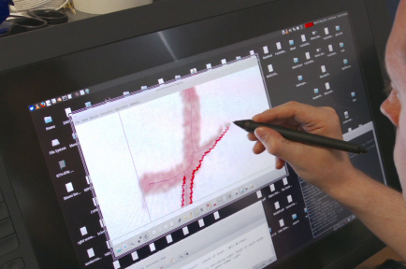
Contributions
Model that recreates handwriting in a given style
Handwriting Annotation Tool
Notes:
As a one time input to our system the user annotates a sample of the handwriting style they wish to synthesize.
To greatly speed up this step we introduce a semi automatic handwriting annotation tool.

Slide 20
Contributions
Model that recreates handwriting in a given style
Handwriting Annotation Tool
End to end calibration and rendering pipeline
Notes:
Finally, our end to end rendering pipeline can be calibrated to enable it to print in the same color as the target sample of writing.
We evaluate our system with several perceptual user studies and show that it is capable of fooling humans observers.

Slide 21
Handwriting Synthesis Pipeline
Notes:
Our system consists of three main components.

Slide 22
Handwriting Synthesis Pipeline
Data Preparation
Notes:
First, data preparation where we scan and annotate handwriting samples from paper so that they are ready for automatic synthesis.
This is a one time step and typically takes on the order of 30 minutes for a paragraph of text using our annotation tool.

Slide 23
Handwriting Synthesis Pipeline
Data Preparation
Automatic Synthesis
Notes:
Our fully automatic synthesis step uses the annotated writing from the previous stage and can generate an unlimited amount of output sentences in the same style as the input.

Slide 24
Handwriting Synthesis Pipeline
Device
Calibration
Data Preparation
Automatic Synthesis
Notes:
Finally, our printer calibration stage enables us to print handwriting using standard inkjet printers that resemble the original real pen on paper input.

Slide 25
Handwriting Synthesis Pipeline
Data Preparation
Notes:
First, we will walk through the steps involved in preparing the handwriting samples for synthesis.

Slide 26
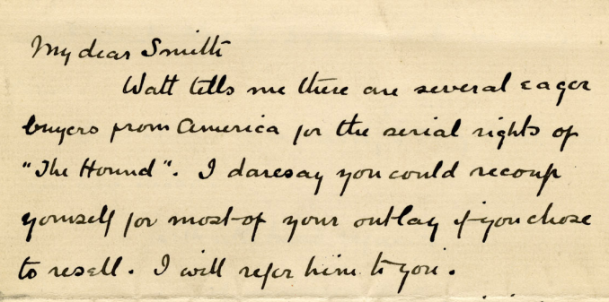
Obtaining Handwriting Samples
Author unavailable
Scan in historical handwriting sample
Author available
Give them text to write out, optimize for coverage
Notes:
The example input handwriting used by our system can come in two different forms.
For deceased historical figures we are limited to the handwriting samples that have survived in good condition.
(C) Alternatively, if the author is available we can generate the text for them to write out.

Slide 27
Optimizing the Source Text
“shrugging his shoulders”
Notes:
For cooperative authors, we make use of the top 100 English language books on project Guttenberg as source text.
Then we use an optimization based approach to automatically select a subset of the sentences to maximize the coverage of individual letters and their commonly occurring pairwise combinations.
In this sentence fragment we see several examples of the letter “h” (C).
They appear in both different positions and with different neighboring letters, resulting in variation in the way they are written.

Slide 28
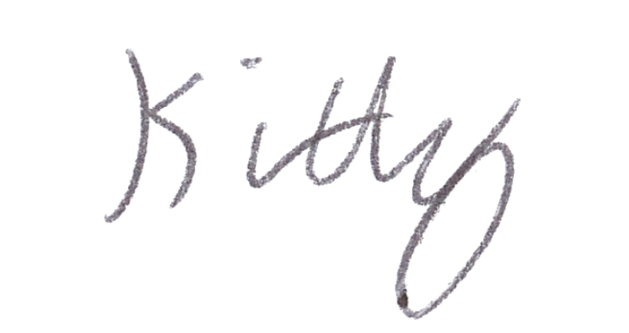
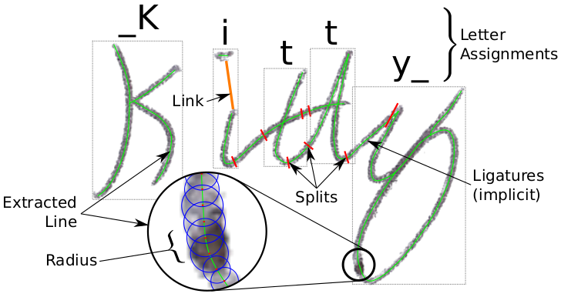
Data Preparation
Input
Sample of handwriting
Output
Annotated handwriting
Notes:
Once a scanned sample of the authors handwriting has been acquired, the goal of the data preparation step is to (C) segment the ink from the scanned image and tag pixels with their associated source text letters.

Slide 29
Manual Tagging
Notes:
Manual tagging of a handwriting sample, involving the painful process of segmenting the individual glyphs by hand, would be an extremely time consuming task.

Slide 30
Semi-Automatic Tagging Interface
Notes:
To significantly speed up this step we introduce a semi automatic interface that, where possible, attempts to aid the annotation while also ensuring that the user still has the ability to fix any mistakes.

Slide 31
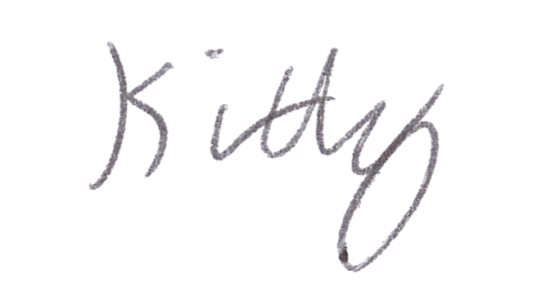
Input Sample
Notes:
We begin with the scanned sample of the input handwriting.
As a running example, here will we illustrate the main steps of tagging using the word “Kitty” written on plain white paper.
It is worth noting that our approach is robust enough to deal with different pen and paper styles and effects due to aging on the paper.

Slide 32
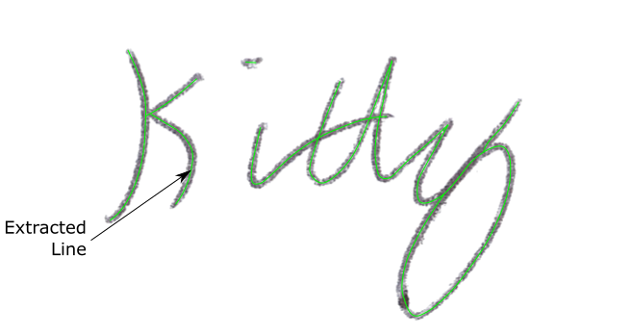
Line Extraction and Segmentation
Notes:
Our automatic segmentation and skeletonization extracts a vectorized line from the input sample, here shown in green.
If there are any mistakes with this step the user is able to manually fix them and rerun the segmentation.

Slide 33
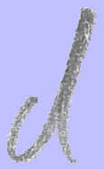
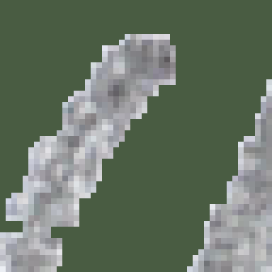
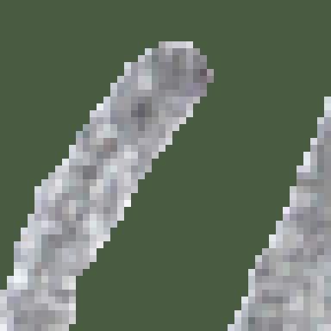
Line Aware Smoothing
Without smoothing
With smoothing
Notes:
After the initial segmentation we perform a line aware smoothing step which results in better segmentation for writing implements such as the pencil (C) shown in this example.

Slide 34
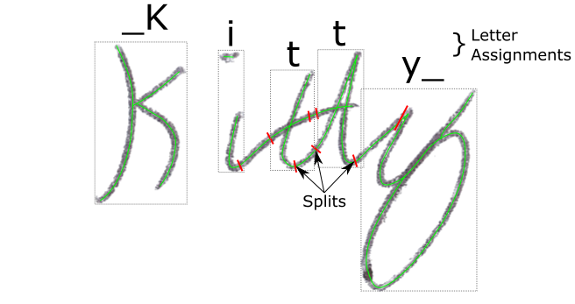
Letter Assignment
Notes:
Next, two main types of tags are assigned to the now vectorized input.
First, splits which indicate where individual letters transition into the ligatures connecting them.

Slide 35
Letter Assignment
Notes:
And secondly, a label which assigns the correct character to the region of the input.
To automatically perform this character assignment we use a supervised learning approach that attempts to predict the corresponding letter for each pixel in the input.
We then regularize this prediction using a dynamic programming solution.

Slide 36
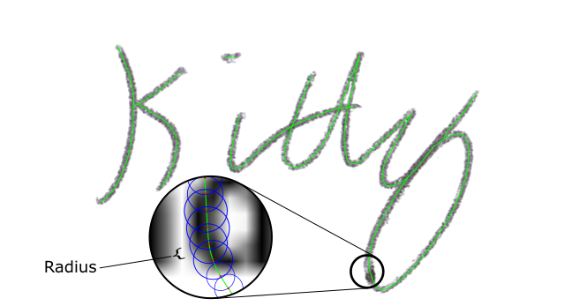
Ink Density
Notes:
As most pens do not consistently deposit ink on the paper we extract the ink density which we use later during synthesis.
Density is computed as the average ink deposited in a circular region at each point along the pen’s path.

Slide 37
Timings
Pen | Mode | Line Extraction | Tagging | Total Time
Fine liner | Fully Manual | 12:13 | 3:02 | 16:15
Time spent annotating three pages
Units hours:mins
Notes:
Manually tagging and segmenting several pages of text is prohibitively expensive even for writing implements like fineliners that deposit ink uniformly.

Slide 38
Timings
Pen | Mode | Line Extraction | Tagging | Total Time
Fine liner | Fully Manual | 12:13 | 3:02 | 16:15
Fine liner | Semi Automatic | 0:17 | 2:24 | 2:54
Time spent annotating three pages
Units hours:mins
Notes:
Our semi automatic approach reduces this effort by a factor of five.
Here the majority of the time is spent fixing the automatic letter classification and split assignment.
This can be further improved by retraining the classifier online so that it learns the specific authors writing style.

Slide 39
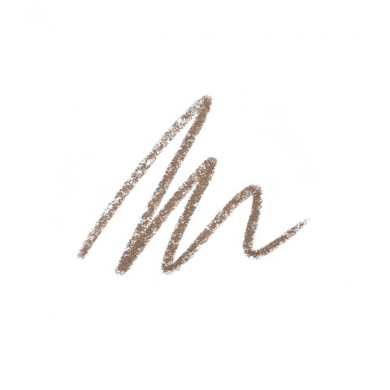
Timings
Pen | Mode | Line Extraction | Tagging | Total Time
Fine liner | Fully Manual | 12:13 | 3:02 | 16:15
Fine liner | Semi Automatic | 0:17 | 2:24 | 2:54
Messy Pencil | Semi Automatic | 3:06 | 2:21 | 5:37
Time spent annotating three pages
Units hours:mins
Notes:
Implements such as pencils can sometimes be very difficult to segment from the page as pencil lines can be inconsistent and contain gaps.
This messiness appears for most pencils and cheap ball-point pens.
As a result this can increase the amount of time the user spends fixing the segmentation.
While our interface has been presented in the context of handwriting, it could be used for general line vectorization in sketch images.

Slide 41
Handwriting Synthesis
Automatic Synthesis
Notes:
Once the writing sample has been tagged we can now proceed to the generation step.

Slide 42
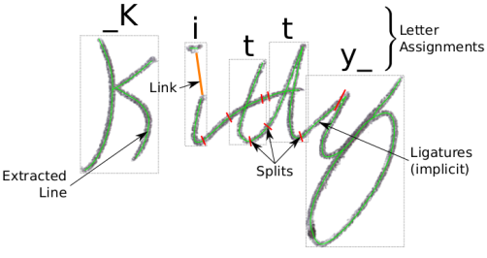
Handwriting Synthesis
Input
Annotated handwriting
Output
Handwriting as a texture
Text to generate
“There are many scenarios where …”
Notes:
Our input is a tagged handwriting sample, and the new text (C) we wish to generate in that input’s style.
The output (C) is an image of the rendered text.

Slide 43
Synthesis as Energy Minimization
Glyph
Selection
Glyph
Layout
Ligatures
Texture
Notes:
We pose automatic handwriting synthesis as an energy minimization problem where our energy consists of four main terms.
(C) First, selecting the characters we wish to render (C) Placing those characters on the page (C) Joining them together if they are connected by ligatures (C) And finally, applying the pen texture to the output image

Slide 44
Random Glyph Selection
Random selection
Word: dilapidated
Notes:
Using the word “dilapidated” as a running example we can see that simply randomly selecting glyphs and rendering them with a constant spacing results in an unrealistic output.
The individual glyphs do not flow into each other and ink density between neighboring glyphs in uneven.
This approach closely relates to some existing published methods and we will use it as a baseline in our user studies later in the talk.

Slide 45
Our Glyph Selection
Our dynamic programming selection
Notes:
Our algorithm improves upon random selection by using dynamic programming to select visually coherent glyphs.
At this point however, the spacing between the glyphs still doesn’t look natural.

Slide 46
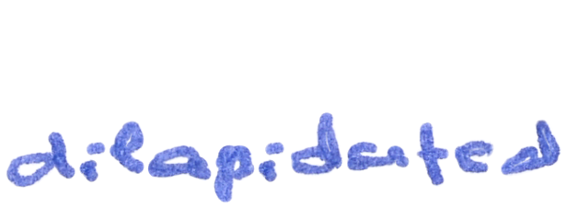
Glyph Layout
Horizontal spacing
Notes:
To overcome this problem we adjust the horizontal spacing based on the original relationship between them in the input handwriting samples.
[PAUSE]
To fix the vertical alignment we use a random forest to model the distribution over possible vertical offsets and then integrate this information using a Kalman filter.

Slide 47
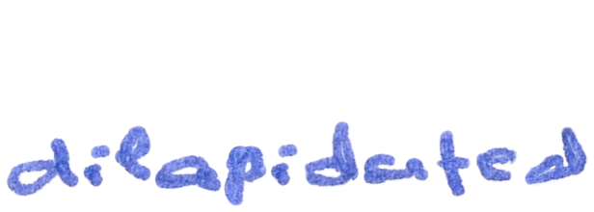
Glyph Layout
Vertical spacing
Notes:
Natural handwriting is rarely aligned with page rules, and this step incorporates the visual flow of real writing.

Slide 48
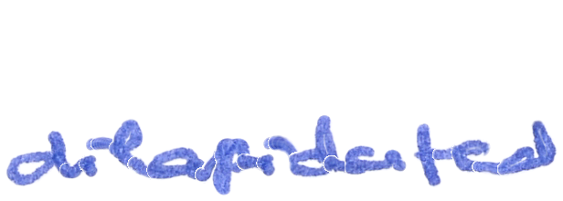
Ligatures
Notes:
We add ligatures if they are present in the source sample.
However, naively joining glyphs together results in visual artifacts.

Slide 49
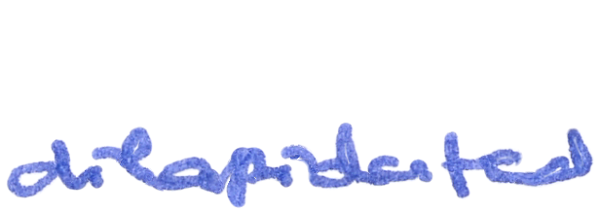
Texturing
Notes:
To overcome this we use graph cut textures to hide these seams.

Slide 50
Comparison to Real Sample
Our Result
Real Sample
Notes:
Comparing our result to a real handwriting sample from the same individual shows that we can produce a rendering that is faithful to the input style.
Note that this author has the unusual style of sometimes joining the dots on the i’s to the subsequent characters.
We do not hard-code this behavior but our algorithm replicates this stylistic trait as it appears in the input data.

Slide 51
Solving
Each stage ﬁxes relevant details while approximating other costs with proxies
STAGE
FIXES
CORE TECHNIQUE
Selection
Layout
Ligatures
Texturing
Glyphs used
Glyph positions
Ligature existence
Output texture
Dynamic programming
Kalman smoothing
Heuristic
Graph cuts
Notes:
Optimizing the global cost function would be extremely challenging especially as we desire synthesis at near interactive rates.
So instead, each step is optimized in the order presented using proxy terms to approximate the remaining terms at each stage of optimization.

Slide 52
Generating Variation
Notes:
To create variation in the output handwriting a small amount of noise is introduced during the optimization.
(C) Here are some examples illustrating the different outputs we can generate in the same handwriting style. C) C) …

Slide 54
Color Calibration
Device
Calibration
Notes:
There is one last calibration step required if the user wishes to print the generated handwriting on real paper so that the colors match the scanned source.
We’re closing the loop from scanned input to physical output.

Slide 55
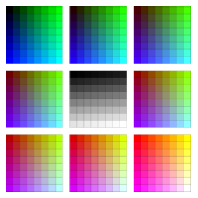
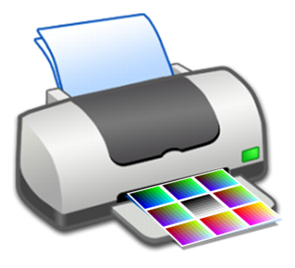
Color Calibration
Print Color
Calibration Target
Scan Target
Notes:
The user simply prints out a color calibration target and (C) then scans it back into the computer using the same device that was used to capture the source handwriting sample.
Off-the-self inkjet printers lack the dynamic range to cover most pen inks, however they are sufficient for commonly used writing implements such as ballpoint pens and pencils.

Slide 56
Color Calibration
Print Color
Calibration Target
Scan Target
Notes:
We found that inkjet printers perform much better than laser printers for this task as they tend to have a larger color space with a more accurate color reproduction.
Plus the ink bleeds into the page slightly – similar to a real pen.

Slide 58
Results
Notes:
Now we will show some results for our system.
Here we have annotated handwriting examples from famous historical figures and then generated new sentences in their style.

Slide 59
Historical Synthesis - Abraham Lincoln
Real sample from author
Our result
Notes:
First we show a example from the famous Bixby letter, purported to have been written by Abraham Lincoln.
(C) Our result, when superimposed on the original letter paper looks convincing.
We show a famous quote attributed to Lincoln and rendered in his own hand writing style.

Slide 60
Historical Synthesis - Frida Kahlo
Real sample from author
Our result
Notes:
Next we show an example from the artist Frida Kahlo.
(C) Note that she has very different style, with the unusual characteristic of sometimes drawing ligatures that lead into words.

Slide 61
Historical Synthesis - Arthur Conan Doyle
Real sample from author
Our result
Notes:
And finally we render the sentence (C) “elementary my dear Watson”, famously never written, by the Sherlock Holmes author - Arthur Conan Doyle.
All of these examples took a novice user less than 45 minutes to tag for a paragraph of the original writing.
Generating this or any other new outputs then only takes a few seconds.

Slide 62
User Studies

Slide 63
User Studies
1
Realism
2
Style
3
Calibration
Notes:
We evaluated the quality of our results with three perceptual user studies.
Evaluating realism, style synthesis, and our calibration.

Slide 64
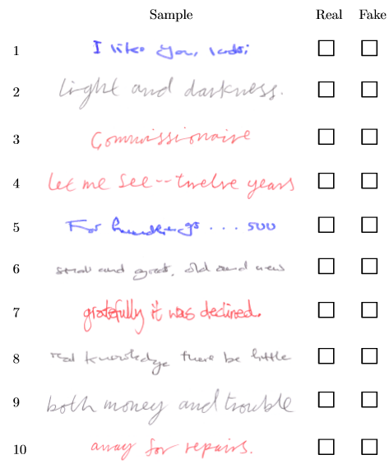
1
Can we synthesize realistic handwriting?
Notes:
In our first user study we presented participants with a printed questionnaire featuring a series of sentence fragments, shown on the right, and they had to determine if each was real or fake.
We choose the word “fake” as opposed to alternatives such as “computer generated” as we didn’t want to bias participants into expecting any particular types of forgery artifacts.

Slide 65
1
Can we synthesize realistic handwriting?
Percentage of correct guesses
Notes:
If they were not able to tell the difference between the real and fake sentences their result would be 50%, as there was an even number of each type of writing in the questionnaire.

Slide 66
1
Can we synthesize realistic handwriting?
Percentage of correct guesses
Notes:
If the answers were very obvious they would achieve a score of 100%.

Slide 67
1
Can we synthesize realistic handwriting?
Percentage of correct guesses
Notes:
When judging our algorithm, participants only guessed the correct answer 54% of the time on average.
This is close to random guessing.

Slide 68
1
Can we synthesize realistic handwriting?
Percentage of correct guesses
Notes:
As a point of comparison when we used one of the baseline algorithms presented earlier they did a better job at spotting the synthesized results.

Slide 69
2
Can we synthesize handwriting in the same style
as a given author?
Notes:
In our second, more challenging, study we first showed an example of an authors handwriting on top.
(C) And then asked which of the two samples below was fake.

Slide 70
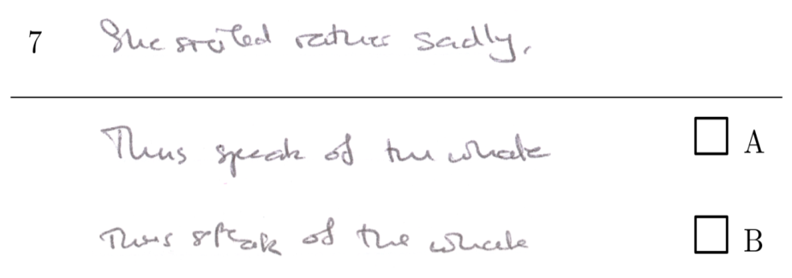
2
Can we synthesize handwriting in the same style
as a given author?
Percentage of correct guesses
Notes:
Participants only guessed the correct answer 52% of the time for us, compared to 72% for the baseline.
Again, this shows that our approach is more capable of fooling real participants.

Slide 71
3
On Paper Synthesis
15 envelopes
7 handwritten (pen)
8 synthesized (printed)
Notes:
In our final credit-card delivery study, we presented participants with a set of 15 handwritten envelopes, half of which were generated by our system and the rest were created using real pens.
When printing our synthesized results, we ﬁrst color calibrated a standard inkjet printer using the printer calibration approach outlined earlier.
Participants were given 5 seconds per envelope in indoor office lighting at normal reading distance.

Slide 72
3
On Paper Synthesis
15 envelopes
7 handwritten (pen)
8 synthesized (printed)
Correct answer 61% of time
Notes:
They guessed the correct answer only 61% of the time.
This shows that we are able to render text on paper that is close to indistinguishable to real handwriting to casual observers.

Slide 73
Envelope Synthesis
Notes:
Here we show a subset of the test envelopes.

Slide 74
Further Applications
Notes:
Finally we show some other qualitative applications of our method.

Slide 75
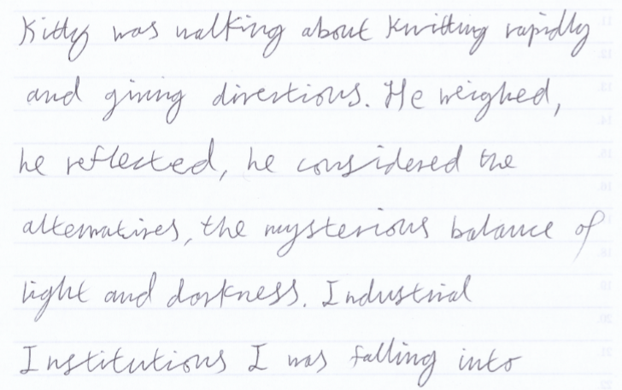
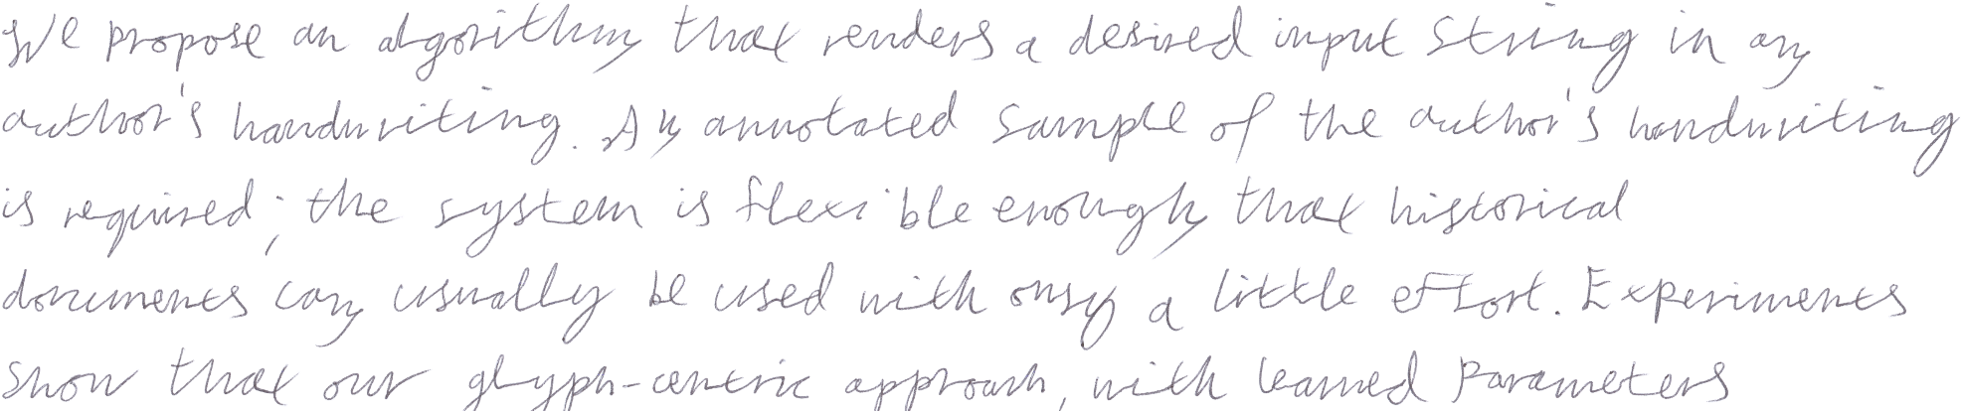
Paragraphs of Text
Notes:
Here we see that our system is capable of generating, not just individual sentences, but full paragraphs of text.
(C) For comparison we can see that it closely resembles an original handwriting sample from the author.

Slide 76
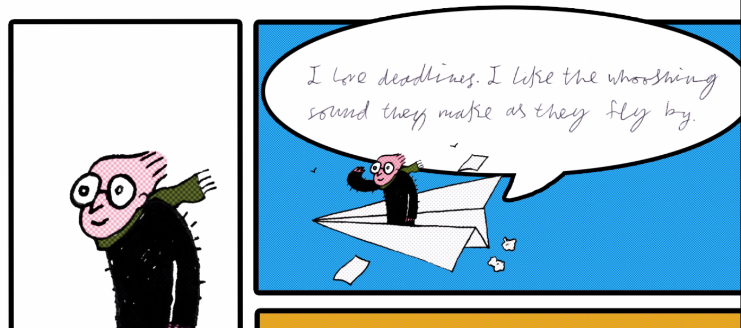
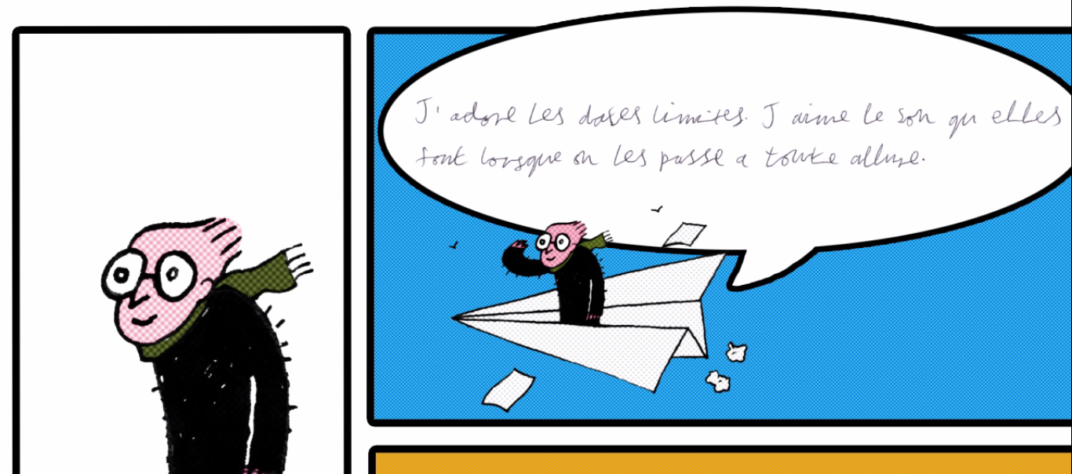
Comic Lettering
Notes:
We can replace lettering in comic books, enabling us to translate the text into (C) different languages while retaining the same style.

Slide 77
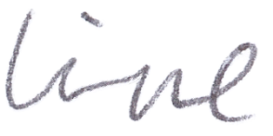
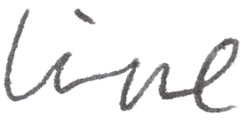
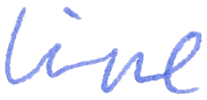
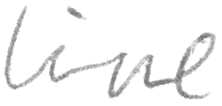
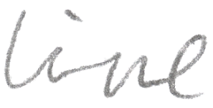
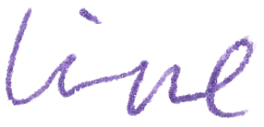
Line Replacement
Ball point
Fountain
(black)
Fountain
(blue)
Green marker
Mechanical
pencil
HB pencil
Gel pen
Crayon
Notes:
Our authors provide a sample of their handwriting using only one pen, but the end user may wish to render new handwriting in another pen style.
Our system allows complete replacement of the line with a writing implement of the user’s choice.

Slide 78
Line Replacement
Ball point
Fountain
(black)
Fountain
(blue)
Green marker
Mechanical
pencil
HB pencil
Gel pen
Crayon
Notes:
Our automatic replacement encourages the output to have similar ink density, radius, and shape to the input.
It is worth noting that while this obtains plausible results it does model the changes in line shape that can result when using different writing implements - for example using a crayon instead of a pencil.

Slide 79
Text Replacement in Film
Notes:
We can also change handwritten text in movies, giving the director the ability to adjust content without having to reshoot.
Similarly for video games, the rendered handwriting can now be conditioned on the current game state.

Slide 80
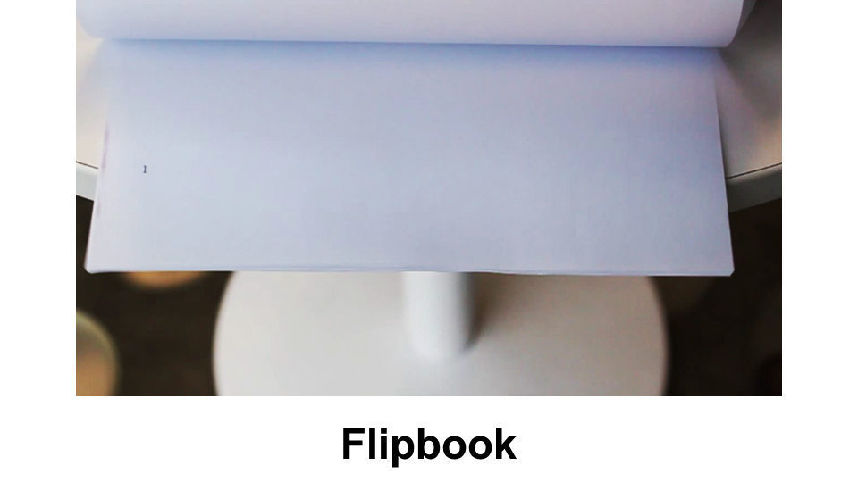
Flipbook
Notes:
As we can generate large quantities of handwritten text automatically, we remove the tedium involved when creating physical objects such as flipbooks.

Slide 81
Flipbook

Slide 82
Limitations
Real
Synthetic
Albert Einstein’s handwriting
Notes:
Our system requires good quality data as input.
As can be seen in this example of Albert Einstein’s handwriting, (C) our result does not quite match the input as there was insufficient characters tagged and the input data is low resolution.

Slide 83
Limitations
Real
Synthetic
Albert Einstein’s handwriting
Notes:
Certain types of very decorative handwriting styles are difficult to model as are languages with high character counts such as Chinese that would require a large number of input samples.
The current bottleneck in our pipeline is the once off annotation step.
This stage could be further sped up with improved automatic character recognition.

Slide 85
Conclusion
Model that recreates handwriting in a given style
Handwriting Annotation Tool
End to end calibration and rendering pipeline
Notes:
In summary we have presented a data driven generative model of human handwriting.
To help the labeling of the input data we have introduced a semi automatic handwriting annotation tool to greatly speed up the tagging of text.
We have evaluated our system with user studies and have show that we are capable of fooling human participants.

Slide 86
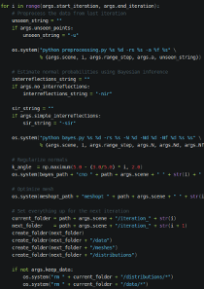
http://visual.cs.ucl.ac.uk/pubs/handwriting
Tagging Interface
Data
Synthesis Code
Notes:
So please visit our project website for the tagging and synthesis code that will enable you to render handwriting images in your own style. Thanks for your attention!

